Slide 1

Modern C++元编程应用
祁 宇
qicosmos@163.com
purecpp.org

Slide 2
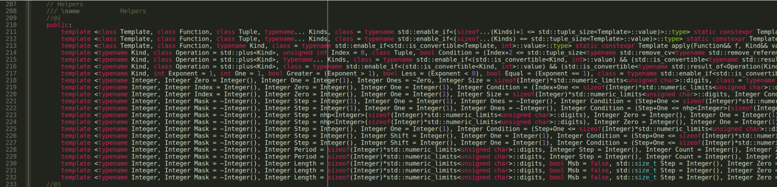
模版元
Notes:
From:https://github.com/CppCon/CppCon2018/blob/master/Presentations/from_metaprogramming_tricks_to_elegance/from_metaprogramming_tricks_to_elegance__vincent_reverdy__cppcon_2018.pdf

Slide 3
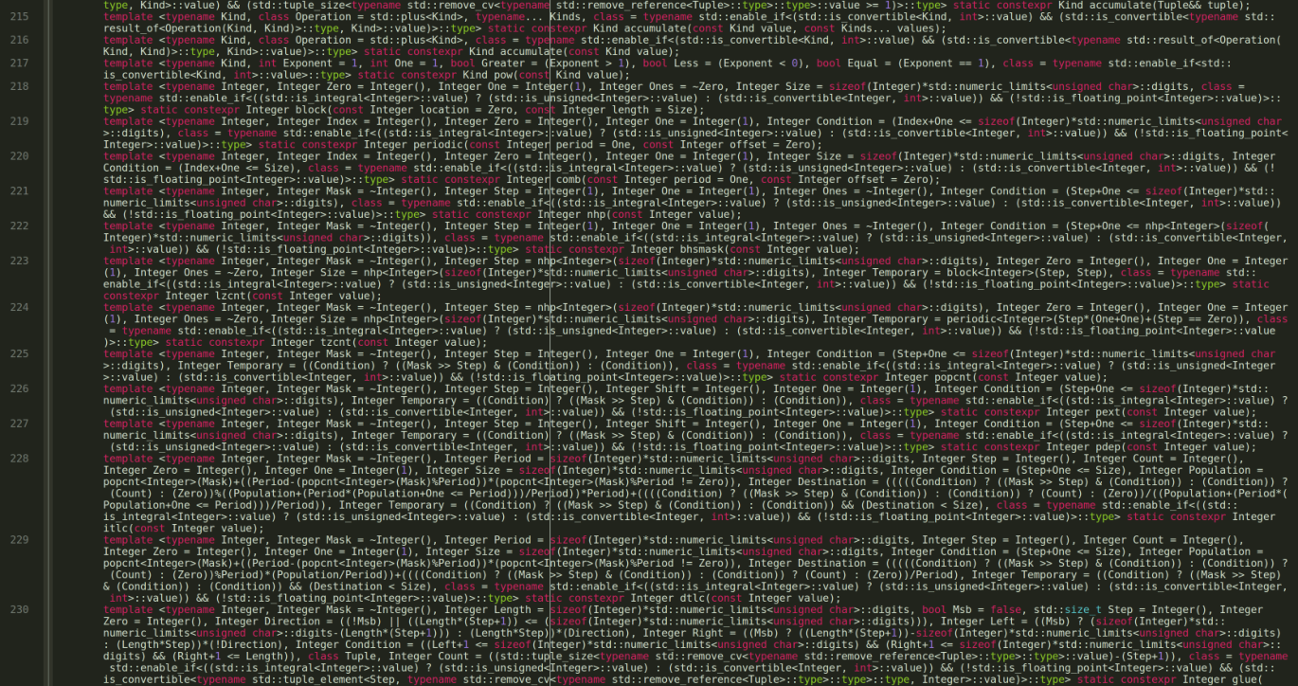

Slide 4
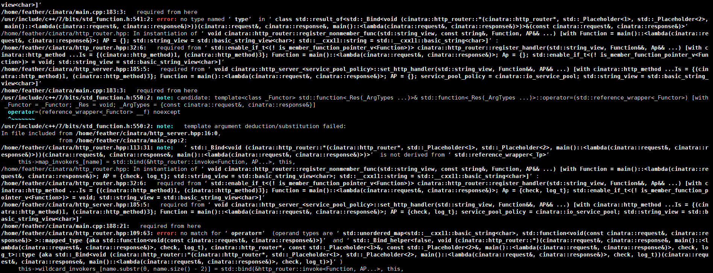
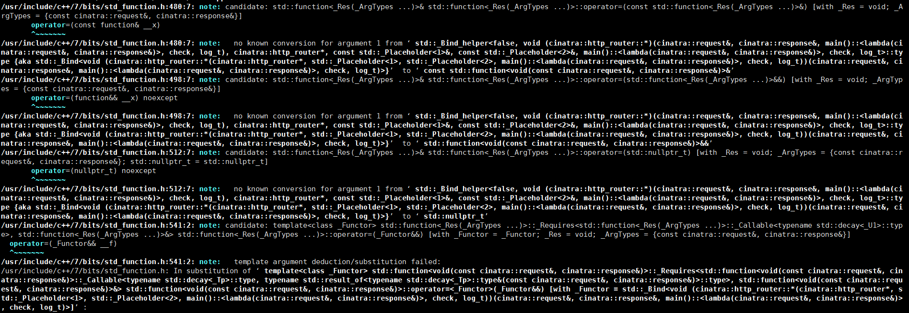

Slide 5

!! 模版元 代码墙!!
在中国C++大会上??

Slide 6
元编程的缺点
代码晦涩
比较难写
编译时间长
糟糕的错误提示

Slide 7
元编程的优点
zero-overhead 编译期计算
简洁而优雅地解决问题
终极抽象
Dream code!

Slide 8


Slide 9
Meta Programming编程思想
In C++98
元函数
SFINAE
模版递归
递归继承
Tag Dispatch
模版特化/偏特化

Slide 10
Meta Programming编程思想
In C++98
template<class T>
struct add_pointer { typedef T* type; };
typedef typename add_pointer<int>::type int_pointer;
元函数：编译期函数调用的类或模版类– add_pointer
调用元函数：访问元函数的内部类型::type
Type T作为元函数的value，类型是元编程中的一等公民
模版元编程概念上是函数式编程

Slide 11
Meta Programming编程思想
In C++98
template<bool B, class T = void>
struct enable_if {};
template<class T>
struct enable_if<true, T> { typedef T type; };
template <class T>
typename enable_if<sizeof(T)==4, void>::type
foo(T t) {}
foo(1); //ok
foo('a'); //compile error
SFINAE：替换失败不是一个错误，基于模版实例化的tag dispatch

Slide 12
Meta Programming编程思想
In C++98
template <int n> struct fact98 {
static const int value = n * fact98<n - 1>::value;
};
template <> struct fact98<0> {
static const int value = 1;
};
std::cout << fact98<5>::value << std::endl;
模版递归

Slide 13
Meta Programming编程思想
In C++98
模版元编程集大成者：boost.mpl, boost.fusion
boost.mpl：编译期类型容器和算法
boost.fusion：通过异构的编译期容器融合编译期和运行期计算
struct print{
template <typename T>
void operator()(T const& x) const{
std::cout << typeid(x).name() << std::endl;
}
};
template <typename Sequence>
void print_names(Sequence const& seq){
for_each(filter_if<boost::is_class<_> >(seq), print());
}
boost::fusion::vector<int, char, std::string> stuff(2018, 'i', "purecpp");
print_names(stuff);

Slide 14
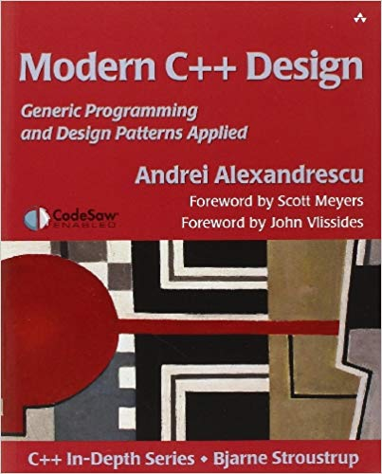

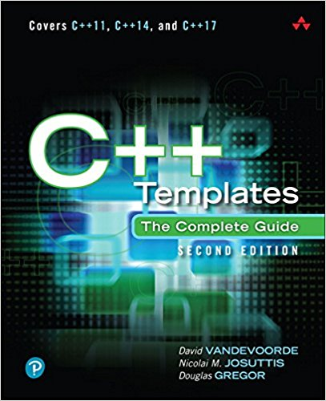
Meta Programming编程思想
In C++98
Andrei Alexandrescu

Slide 15
Meta Programming编程思想
In C++98
In C++11
template<class T>
struct add_pointer { typedef T* type; };
typedef typename add_pointer<int>::type int_pointer;
template<class T> using add_pointer = T*;
using int_pointer = add_pointer<int>;
C++11 template aliases（模版别名）
元函数由类和类模版变为模版别名

Slide 16
Meta Programming编程思想
In C++11
template<typename... Values> struct meta_list {};
using list_of_ints = meta_list<char, short, int, long>;
template<class List> struct list_size;
template<template<class...> class List, class... Elements>
struct list_size<List<Elements...>>
: std::integral_constant<std::size_t, sizeof...(Elements)> {};
constexpr auto size = list_size<std::tuple<int, float, void>>::value;
constexpr auto size1 = list_size<list_of_ints>::value;
constexpr auto size2 = list_size<boost::variant<int, float>>::value;
C++11 Variadic Templates
Variadic templates作为类型容器
通过variadic templates pack访问模版参数，不通过模版递归和特化

Slide 17
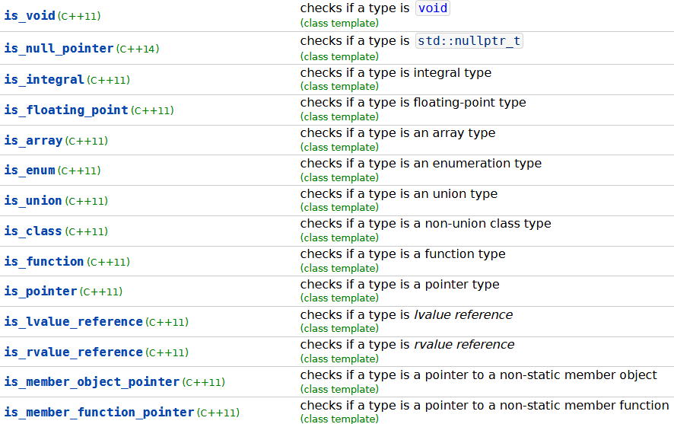
Meta Programming编程思想
C++11 type_traits提供了大量的元函数，让模版元编程变得更简单

Slide 18
Meta Programming编程思想
In C++98
In C++11
template <int n> struct fact98 {
static const int value = n * fact98<n - 1>::value;
};
template <> struct fact98<0> {
static const int value = 1;
};
std::cout << fact98<5>::value << std::endl;
constexpr int fact11(int n) {
return n <= 1 ? 1 : (n * fact11(n - 1));
}

Slide 19
Meta Programming编程思想
In C++11
In C++14
constexpr int fact11(int n) {
return n <= 1 ? 1 : (n * fact11(n - 1));
}
constexpr int fact14(int n) {
int s = 1;
for (int i = 1; i <= n; i++) { s = s * i; }
return s;
}

Slide 20

Meta Programming编程思想
In C++14
Everything changed in meta programming
新特性产生新的编程思想！
constexpr, generic lambda, variable template
Boost.hana
Louis Dionne

Slide 21
Meta Programming编程思想
Boost.hana
template <typename T>
struct type_wrapper {
using type = T;
};
template <typename T>
type_wrapper<T> type{};
//type to value
auto the_int_type = type<int>;
//value to type
using the_real_int_type = decltype(the_int_type)::type;

Slide 22
Meta Programming编程思想
Boost.hana
template <typename T>
type_wrapper<T> type{};
constexpr auto add_pointer = [](auto t) {
using T = typename decltype(t)::type;
return type<std::add_pointer_t<T>>; //type to value
};
constexpr auto intptr = add_pointer(type<int>);
static_assert(std::is_same_v<decltype(intptr)::type, int*>); //value to type
元函数的定义不再是类了，而是lambda!
generic lambda, variable template, constexpr
functional programming

Slide 23
Meta Programming编程思想
Boost.hana
auto animal_types = hana::make_tuple(hana::type_c<Fish*>, hana::type_c<Cat&>, hana::type_c<Dog*>);
auto animal_ptrs = hana::filter(animal_types, [](auto a) {
return hana::traits::is_pointer(a);
});
static_assert(animal_ptrs == hana::make_tuple(hana::type_c<Fish*>, hana::type_c<Dog*>), "");
auto animals = hana::make_tuple(Fish{ "Nemo" }, Cat{ "Garfield" }, Dog{ "Snoopy" });
auto names = hana::transform(animals, [](auto a) {
return a.name;
});
assert(hana::reverse(names) == hana::make_tuple("Snoopy", "Garfield", "Nemo"));
通过类型容器融合编译期和运行期计算，替代boost.mpl和boost.fusion!

Slide 24
Meta Programming编程思想
Boost.hana
元函数不再是类或类模版，而是lambda
不再基于类型，而是基于值
没有SFINAE，没有模版递归
函数式编程
代码更容易理解
元编程变得更简单
融合编译期与运行期

Slide 25
Meta Programming编程思想
In C++14
In C++17
template<std::size_t I>
auto& get(person& p);
template<>
auto& get<0>(person& p) {
return p.id;
}
template<>
auto& get<1>(person& p) {
return p.name;
}
template<>
auto& get<2>(person& p) {
return p.age;
}
template<std::size_t I>
auto& get(person& p) {
if constexpr (I == 0) {
return p.id;
}
else if constexpr (I == 1) {
return p.name;
}
else if constexpr (I == 2) {
return p.age;
}
}
没有特化

Slide 26
Meta Programming编程思想
In C++14
In C++17
template <typename T>
std::enable_if_t<std::is_same_v<T, std::string>, std::string> to_string(T t){
return t;
}
template <typename T>
std::enable_if_t<!std::is_same_v<T, std::string>, std::string> to_string(T t){
return std::to_string(t);
}
template <typename T>
std::string to_string(T t){
if constexpr(std::is_same_v<T, std::string>)
return t;
else
return std::to_string(t);
}
No SFINAE

Slide 27

C++新标准新特性产生新的idea，让元编程变得更简单更强大
C++98: boost.mpl, boost.fusion
C++11: boost.mp11, meta, brigand
C++14: boost.hana
variable templates
generic lambda
constexpr
constexpr
template aliases variadic templates
SFINAE
recursive
tag dispatch
specialize
C++14
C++11
C++98
Newer is Better！

Slide 28
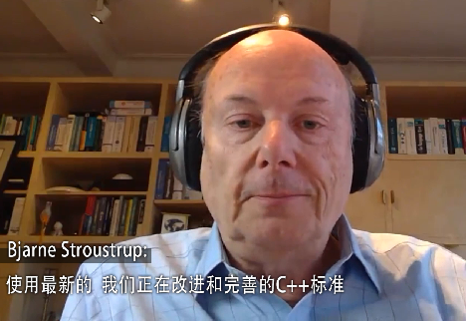

Slide 29

静态检查

Slide 30
静态检查
static_assert(sizeof(void *) == 8, "expected 64-bit platform");
template<typename T, int Row, int Column>
struct Matrix {
static_assert(Row >= 0, "Row number must be positive.");
static_assert(Row >= 0, "Column number must be positive.");
static_assert(Row + Column > 0, "Row and Column must be greater than 0.");
};
Notes:
Put comments in code

Slide 31
静态检查
struct A {
void foo(){}
int member;
};
template<typename Function>
std::enable_if_t<!std::is_member_function_pointer_v<Function>> foo(Function&& f) {
}
foo([] {}); //ok
foo(&A::foo); //compile error: no matching function for call to 'foo(void (A::*)())'
安全，尽可能早地发现bug，让编译器而不是人帮助发现bug
Notes:
Put comments in code

Slide 32
静态检查
编译期探测

Slide 33
探测
template< class, class = void >
struct has_foo : std::false_type {};
template< class T >
struct has_foo< T, std::void_t<decltype(std::declval<T>().foo())> > :
std::true_type {};
template< class, class = void >
struct has_member : std::false_type {};
template< class T >
struct has_member< T, std::void_t<decltype(std::declval<T>().member)> > :
std::true_type {};
struct A {
void foo(){}
int member;
};
static_assert(has_foo< A >::value);
static_assert(has_member< A >::value);
decltype, void_t, SFINAE In C++17
Notes:
Put comments in code

Slide 34
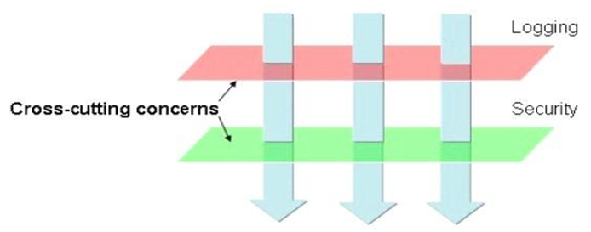
探测
AOP(Aspect Oriented Programming)
Core business
Non-core business aspects

Slide 35
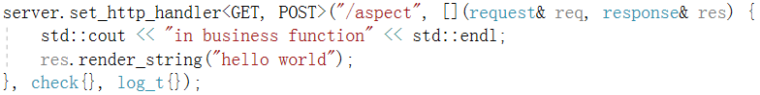
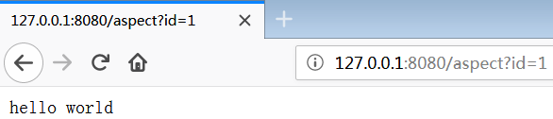
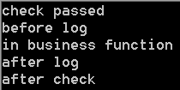
Before aspects
After aspects
request
Core business function
response
check
aspect
log
aspect
log
aspect
check
aspect

Slide 36
探测
AOP
constexpr bool has_befor_mtd = has_before<decltype(item), request&, response&>::value;
if constexpr (has_befor_mtd)
r = item.before(req, res);
constexpr bool has_after_mtd = has_after<decltype(item), request&, response&>::value;
if constexpr (has_after_mtd)
r = item.after(req, res);

Slide 37
探测
AOP(Aspect Oriented Programming)
#define HAS_MEMBER(member)\
template<typename T, typename... Args>\
struct has_##member\
{\
private:\
template<typename U> static auto Check(int) -> decltype(std::declval<U>().member(std::declval<Args>()...), std::true_type()); \
template<typename U> static std::false_type Check(...);\
public:\
enum{value = std::is_same<decltype(Check<T>(0)), std::true_type>::value};\
};
HAS_MEMBER(before)
HAS_MEMBER(after)
AOP in feather : https://github.com/qicosmos/feather

Slide 38
静态检查
编译期探测
编译期计算

Slide 39
编译期计算
类型计算
类型推导
类型萃取
类型转换
数值计算
表达式模版，Xtensor, Eigen, Mshadow

Slide 40
类型萃取
template<typename Ret, typename... Args>
struct function_traits_impl<Ret(Args...)>{
public:
enum { arity = sizeof...(Args) };
typedef Ret function_type(Args...);
typedef Ret result_type;
using stl_function_type = std::function<function_type>;
typedef Ret(*pointer)(Args...);
template<size_t I>
struct args{
static_assert(I < arity, "index is out of range, index must less than sizeof Args");
using type = typename std::tuple_element<I, std::tuple<Args...>>::type;
};
typedef std::tuple<std::remove_cv_t<std::remove_reference_t<Args>>...> tuple_type;
using args_type_t = std::tuple<Args...>;
};
function_traits in cinatra: https://github.com/qicosmos/cinatra

Slide 41
类型萃取
rpc路由
struct rpc_service {
int add(int a, int b) { return a + b; }
std::string translate(const std::string& orignal) {
std::string temp = orignal;
for (auto& c : temp) c = toupper(c);
return temp;
}
};
rpc_server server;
server.register_handler("add", &rpc_service::add, &rpc_srv);
server.register_handler("translate", &rpc_service::translate, &rpc_srv);
auto result = client.call<int>("add", 1, 2);
auto result = client.call<std::string>("translate", "hello");
Modern C++ rpc库rest_rpc: https://github.com/qicosmos/rest_rpc

Slide 42
类型萃取
路由
template<typename Function>
void register_nonmember_func(std::string const& name, const Function& f) {
this->map_invokers_[name] = { std::bind(&invoker<Function>::apply, f, std::placeholders::_1, std::placeholders::_2, std::placeholders::_3) };
}
template<typename Function>
struct invoker {
static void apply(const Function& func, const char* data, size_t size,
std::string& result) {
using args_tuple = typename function_traits<Function>::args_tuple;
msgpack_codec codec;
auto tp = codec.unpack<args_tuple>(data, size);
call(func, result, tp);
}
};

Slide 43
类型萃取
路由
template<typename F, size_t... I, typename... Args>
typename std::result_of<F(Args...)>::type call_helper(
const F& f, const std::index_sequence<I...>&, const std::tuple<Args...>& tup) {
return f(std::get<I>(tup)...);
}
template<typename F, typename... Args>
typename std::enable_if<std::is_void<typename std::result_of<F(Args...)>::type>::value>::type
call(const F& f, std::string& result, std::tuple<Args...>& tp) {
call_helper(f, std::make_index_sequence<sizeof...(Args)>{}, tp);
result = msgpack_codec::pack_args_str(result_code::OK);
}

Slide 44
静态检查
编译期探测
编译期计算
编译期反射

Slide 45
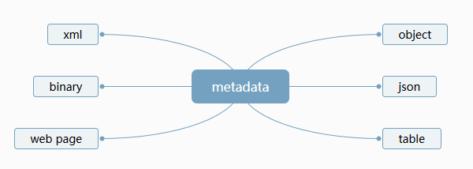
编译期反射
编译期反射
struct person{
std::string name;
int age;
};
REFLECTION(person, name, age)
reflection
reflection

Slide 46
编译期反射
序列化引擎
ORM
协议适配器
person p = {"tom", 20};
iguana::string_stream ss;
to_xml(ss, p);
to_json(ss, p);
to_msgpack(ss, p);
to_protobuf(ss, p);
ormpp::dbng<mysql> mysql;
ormpp:: dbng<sqlite> sqlite;
ormpp:: dbng<postgresql> postgres;
mysql.create_datatable<person>()
sqlite.create_datatable<person>()
postgres.create_datatable<person>()
基于编译期反射的序列化引擎iguana: https://github.com/qicosmos/iguana
基于编译期反射的ORM库ormpp: https://github.com/qicosmos/ormpp

Slide 47
静态检查
编译期探测
编译期计算
编译期反射
融合编译期和运行期

Slide 48
融合编译期和运行期
从运行期到编译期
Value to Type
从编译期到运行期
Type to Value
auto val = std::integral_constant<int, 5>{};
using int_type = decltype(val);
auto v = decltype(val)::value;

Slide 49

融合编译期和运行期
编译期
运行期

Slide 50
融合编译期和运行期
如何根据一个运行时的值调用一个编译期模版函数？
如何将运行时的网络数据映射为一个函数调用？

Slide 51

融合编译期和运行期
template<size_t N>
void fun() {}
void foo(int n) {
switch (n){
case 0:
fun<0>();
break;
case 1:
fun<1>();
break;
case 2:
fun<2>();
break;
default:
break;
}
}
void foo(int n) {
switch (n){
case 0:
fun<0>();
break;
case 1:
fun<1>();
break;
case 2:
fun<2>();
break;
……
case 99:
fun<99>();
break;
default:
break;
}
}
foo(100)??

Slide 52
融合编译期和运行期
namespace detail {
template <class Tuple, class F, std::size_t...Is>
void tuple_switch(const std::size_t i, Tuple&& t, F&& f, std::index_sequence<Is...>) {
(void)std::initializer_list<int> {
(i == Is && (
(void)std::forward<F>(f)(std::integral_constant<size_t, Is>{}), 0))...
};
}
} // namespace detail
template <class Tuple, class F>
inline void tuple_switch(const std::size_t i, Tuple&& t, F&& f) {
constexpr auto N =
std::tuple_size<std::remove_reference_t<Tuple>>::value;
detail::tuple_switch(i, std::forward<Tuple>(t), std::forward<F>(f),
std::make_index_sequence<N>{});
}

Slide 53
融合编译期和运行期
void foo(int n) {
std::tuple<int, int, int> tp;
tuple_switch(n, tp, [](auto item) {
constexpr auto I = decltype(item)::value;
fun<I>();
});
}
foo(1);
foo(2);
foo(100)??

Slide 54
融合编译期和运行期
template<size_t... Is>
auto make_tuple_from_sequence(std::index_sequence<Is...>)->decltype(std::make_tuple(Is...)) {
std::make_tuple(Is...);
}
template<size_t N>
constexpr auto make_tuple_from_sequence()->decltype(make_tuple_from_sequence(std::make_index_sequence<N>{})) {
return make_tuple_from_sequence(std::make_index_sequence<N>{});
}
void foo(int n) {
decltype(make_tuple_from_sequence<100>()) tp; //std::tuple<int, int, …, int>
tuple_switch(n, tp, [](auto item) {
constexpr auto I = decltype(item)::value;
fun<I>();
});
}
foo(98);
foo(99);

Slide 55
融合编译期和运行期
std::tuple：编译期和运行期的桥梁
类型容器
异构的值容器
通过遍历方式同时获得值与类型
std::index_sequence, std::integral_constant
帮助遍历类型和值
帮助获得编译期索引

Slide 56
静态检查
编译期探测
编译期计算
编译期反射
融合编译期和运行期
接口泛化与统一

Slide 57
接口泛化与统一
融合底层异构的子系统
屏蔽差异
提供统一的接口
ORM
mysql
postgresql
sqlite

Slide 58
接口泛化与统一
Mysql connect
mysql_real_connect(handle, "127.0.0.1", "feather", "2018", "testdb", 0, nullptr, 0);
Postgresql connect
PQconnectdb("host=localhost user=127.0.0.1 password=2018 dbname=testdb");
Sqlite connect
sqlite3_open("testdb", handle);
ORM unified connect interface
ORM::mysql.connect("127.0.0.1", “feather", “2018", "testdb");
ORM::postgres.connect("127.0.0.1", “feather", “2018", "testdb");
ORM::sqlite.connect("testdb");

Slide 59
接口泛化与统一
通过可变参数模板统一接口
通过policy-base设计和variadic templates来屏蔽数据库接口差异
template<typename DB>
class dbng{
template <typename... Args>
bool connect(Args&&... args){
return db_.connect(std::forward<Args>(args)...);
}
template<typename... Args>
bool connect(Args... args) {
if constexpr (sizeof...(Args)==5) {
return std::apply(&mysql_real_connect, std::make_tuple(args...);
}
else if constexpr (sizeof...(Args) == 4) {//postgresql}
else if constexpr (sizeof...(Args) == 2) {//sqlite}
}

Slide 60
接口泛化与统一
if constexpr + variadic templates = 静态多态
通过增加参数或修改参数类型方式来扩展接口
没有继承
没有SFINAE
没有模版特化
Modern C++ ORM库: https://github.com/qicosmos/ormpp

Slide 61
静态检查
编译期探测
编译期计算
编译期反射
融合编译期和运行期
接口泛化与统一
消除重复(宏)

Slide 62
消除重复（宏）
#define ENUM_TO_OSTREAM_FUNC(EnumType) \
std::ostream& operator<<(std::ostream& out_stream, const EnumType& x) { \
out_stream << static_cast<int>(x); \
return out_stream; \
}
enum class MsgType { Connected, Timeout };
enum class DataType {Float, Int32};
ENUM_TO_OSTREAM_FUNC(MsgType);
ENUM_TO_OSTREAM_FUNC(DataType);
std::stringstream ss;
ss << MsgType::Connected<< DataType::Float;

Slide 63
消除重复（宏）
#define ENUM_TO_OSTREAM_FUNC(EnumType) \
std::ostream& operator<<(std::ostream& out_stream, const EnumType& x) { \
out_stream << static_cast<int>(x); \
return out_stream; \
}
enum class MsgType { Connected, Timeout };
enum class DataType {Float, Int32};
ENUM_TO_OSTREAM_FUNC(MsgType);
ENUM_TO_OSTREAM_FUNC(DataType);
template<typename T, typename = typename std::enable_if<std::is_enum<T>::value>::type> std::ostream& operator<<(std::ostream& out_stream, T x) { out_stream << static_cast<int>(x); return out_stream; }

Slide 64
消除重复（宏）
#define CALL(name, ...) \
do { \
result ret = func(name); \
if (ret == 0) { \
__VA_ARGS__; \
do_something(name); \
}\
else { \
do_something (name); \
} \
} while (0)
CALL("root", func1(root_path));
CALL("temp", func2(temp_path));

Slide 65
消除重复（宏）
template<typename Self, typename F>
void Call(const std::string& name, Self * self, F f) {
auto ret = foo(name);
if (ret == 0) {
(self >*f)(name);
do_something(name);
}
else {
do_something(name);
}
}
大部分宏能做的，元编程能做得更好，更完美！

Slide 66
静态检查
编译期探测
编译期计算
编译期反射
融合编译期和运行期
接口泛化与统一
消除重复(宏)
接口易用性和灵活性

Slide 67
接口易用和灵活性
struct dummy{
int add(connection* conn, int a, int b) { return a + b; }
};
int add(connection* conn, int a, int b) { return a + b; }
rpc_server server(8080, 4);
dummy d;
server.register_handler("a", &dummy::add, &d);
server.register_handler("b", add);
server.register_handler("c", [](connection* conn) {});
server.register_handler("d", [](connection* conn, std::string s) {
return s;
});
同一个接口可以注册任意类型函数（callable）

Slide 68
接口易用和灵活性
类型擦除
template<typename Function >
void register_nonmember_func(std::string const& name, const Function& f) {
this->map_invokers_[name] = { std::bind(&invoker<Function>::apply, f, std::placeholders::_1, std::placeholders::_2, std::placeholders::_3) };
}
擦除
template<typename Function>
struct invoker {
static void apply(const Function& func, const char* data, size_t size,
std::string& result) {
using args_tuple = typename function_traits<Function>::args_tuple;
msgpack_codec codec;
auto tp = codec.unpack<args_tuple>(data, size);
call(func, result, tp);
}
};
还原
https://github.com/qicosmos/rest_rpc

Slide 69

接口易用和灵活性
Play game！
struct person{
void foo(request& req, response& res) {
res.render_string("ok");
}
};
server.set_http_handler<GET>("/a", &person::foo);

Slide 70
接口易用和灵活性
server.set_http_handler<GET>("/a", &person::foo);
server.set_http_handler<GET, POST>("/b", &person::foo, log_t{});
server.set_http_handler<GET, POST, HEAD>("/c", &person::foo, log_t{}, check{});
server.set_http_handler<GET>("/d", &person::foo, log_t{}, check{}, enable_cache{ false });
server.set_http_handler<GET>("/e", &person::foo, log_t{}, enable_cache{ false }, check{});
server.set_http_handler<POST>("/f", &person::foo, enable_cache{ false }, log_t{}, check{});

Slide 71
接口易用和灵活性
template<http_method... Is, typename Function, typename... AP>
void set_http_handler(std::string_view name, Function&& f, AP&&... ap) {
if constexpr(has_type<enable_cache<bool>, std::tuple<std::decay_t<AP>...>>::value) {
auto tp = filter<enable_cache<bool>>(std::forward<AP>(ap)...);
std::apply(f, std::move(tp));
}
else {
http_router_.register_handler<Is...>(name, std::forward<Function>(f), std::forward<AP>(ap)...);
}
}
template <typename T, typename Tuple>
struct has_type;
template <typename T, typename... Us>
struct has_type<T, std::tuple<Us...>> : std::disjunction<std::is_same<T, Us>...> {};

Slide 72
接口易用和灵活性
template< typename T>
struct filter_helper{
static constexpr auto func(){
return std::tuple<>();
}
template< class... Args >
static constexpr auto func(T&&, Args&&...args){
return filter_helper::func(std::forward<Args>(args)...);
}
template< class X, class... Args >
static constexpr auto func(X&&x, Args&&...args){
return std::tuple_cat(std::make_tuple(std::forward<X>(x)), filter_helper::func(std::forward<Args>(args)...));
}
};

Slide 73

静态检查
编译期探测
编译期计算
编译期反射
融合编译期和运行期
接口泛化与统一
消除重复(宏)
接口易用性和灵活性
使用元编程

Slide 74


Thank you!
Code: https://github.com/qicosmos qicosmos@163.com purecpp.org
Newer is Better!
Notes:
Be able to open the code quickly, print-out -

